Slide 1

The Ear
GTHBY Human Biology

Slide 2
Review
Name three types of neuron.
For each, state whether they are part of the CNS or PNS.
For each, draw a diagram.
Label them as afferent, efferent or inter.

Slide 3
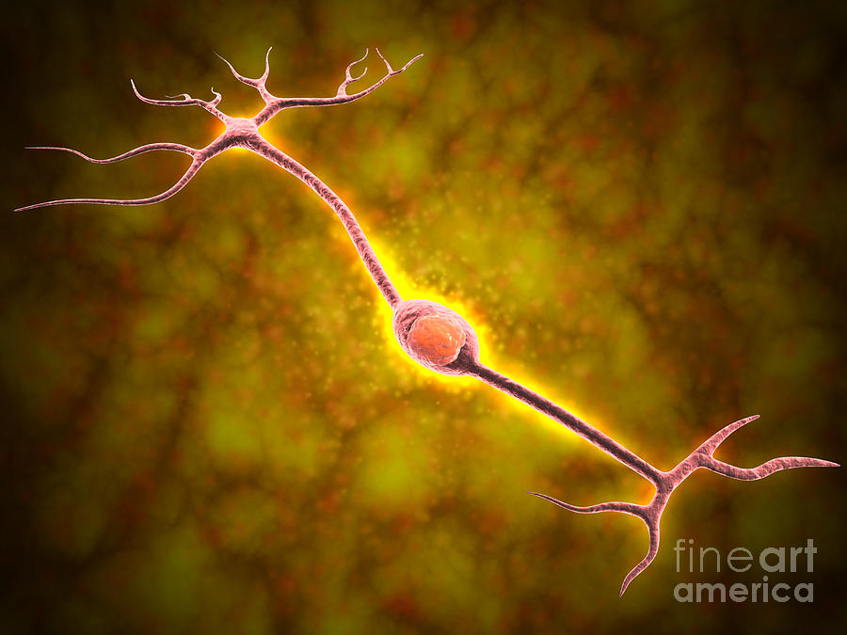
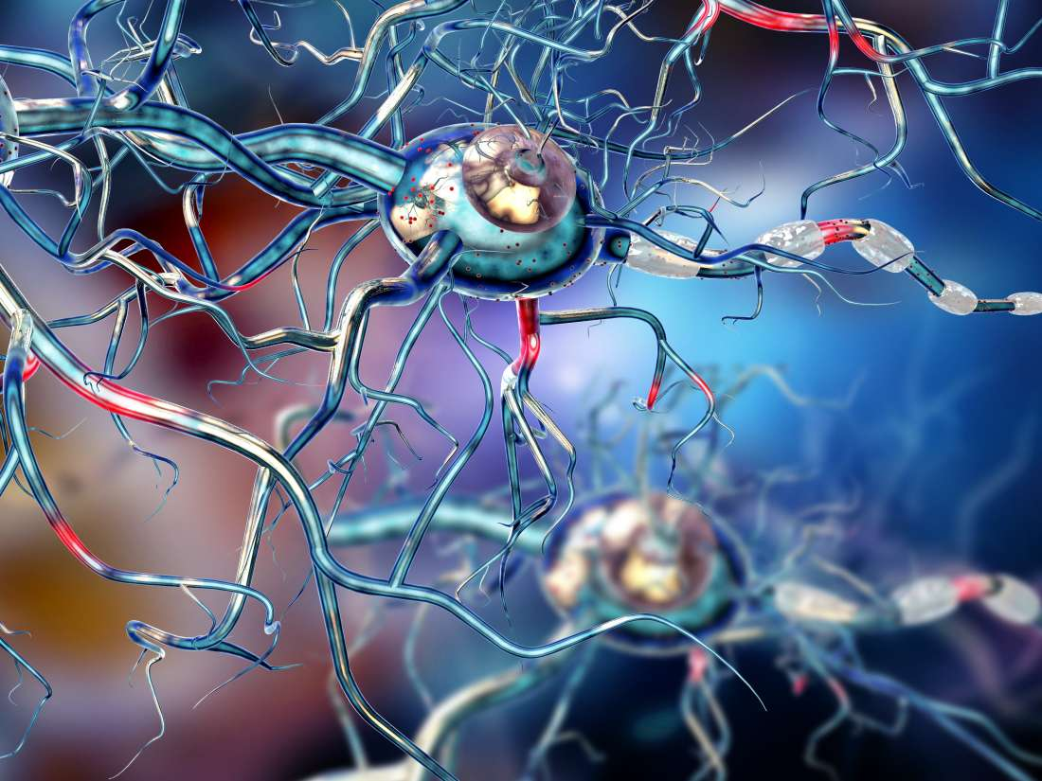
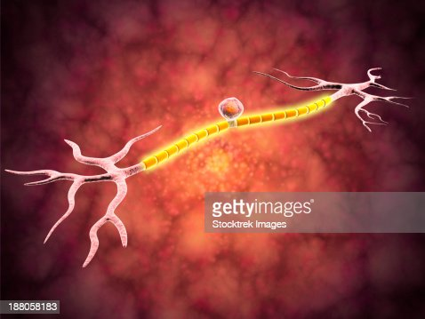
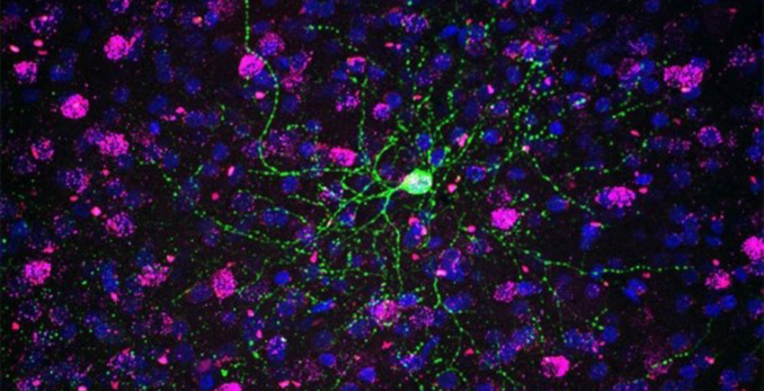
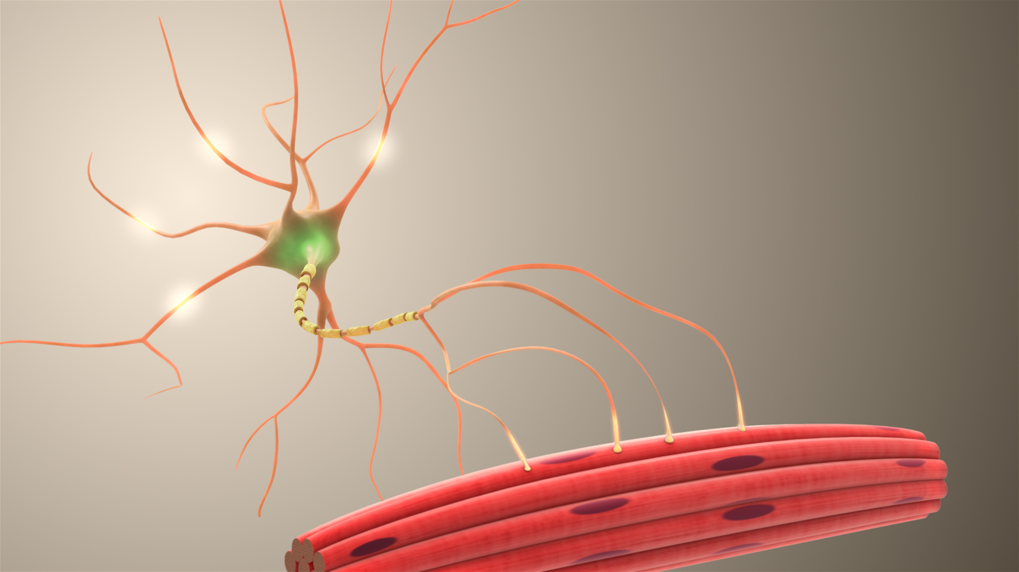
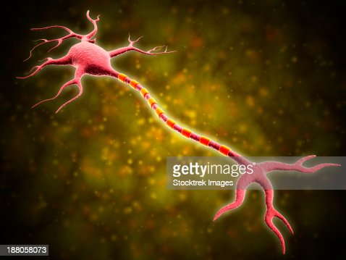
Review:Which type of neuron?

Slide 4
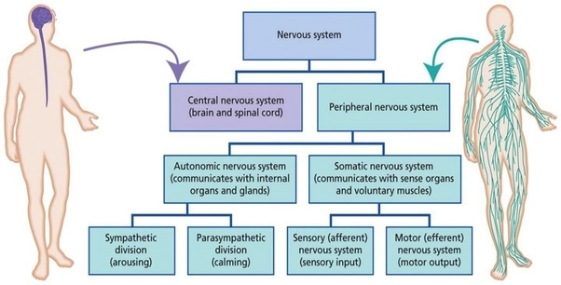

Slide 5
Learning Intentions
Structure of the ear and the stimuli they respond to

Slide 6
Success Criteria
Label an anatomical diagram of an ear
Describe the cochlear as a sensory organ
Describe the auditory nerves as sensory, afferent and somatic parts of the PNS
Explain how pitch and loudness relate to nerve impulses.

Slide 7

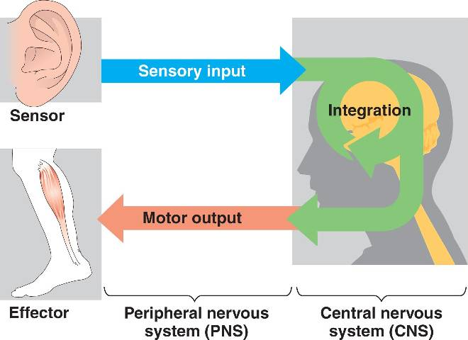
Primary Functions
Sensory (afferent) neurons
Interneurons
Motor (efferent) neurons

Slide 8
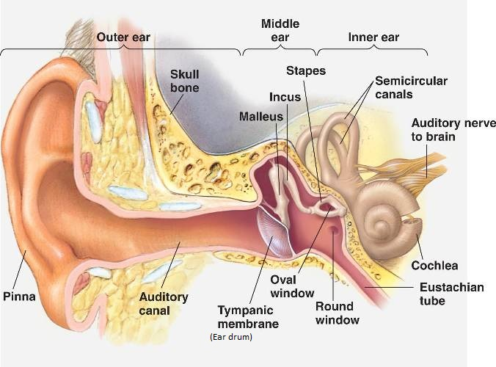

Slide 9
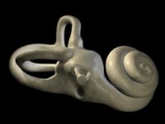

Slide 10
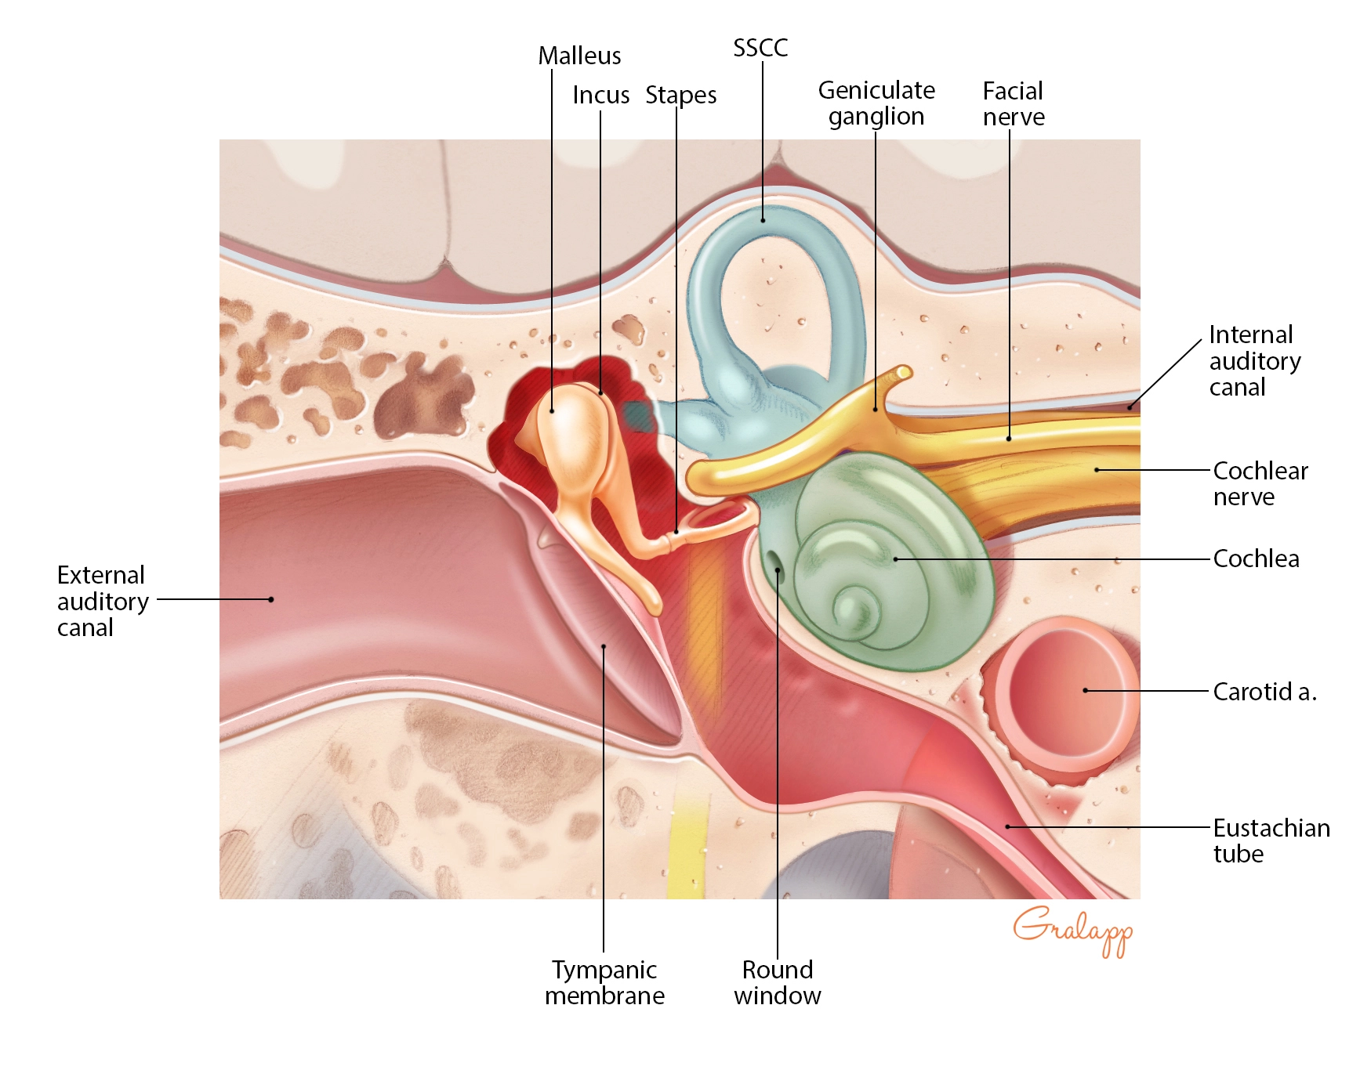

Slide 11
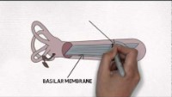

Slide 12
Success Criteria
Label an anatomical diagram of an ear
Describe the cochlear as a sensory organ
Describe the auditory nerves as sensory, afferent and somatic parts of the PNS
Explain how pitch and loudness relate to nerve impulses.

